Slide 1

Spring, 2025
Lecture 3: Random Variables &
Distributions – Part 1

Slide 2
Contents
1
Random Variables
2
Discrete Distributions
3
Continuous Distributions
4
Summary

Slide 3
Random variables &
Discrete distribution
Definition of a Random Variable
Distribution of a Random Variable
Discrete Distributions
Uniform Distributions on Integers
Binomial Distributions

Slide 4
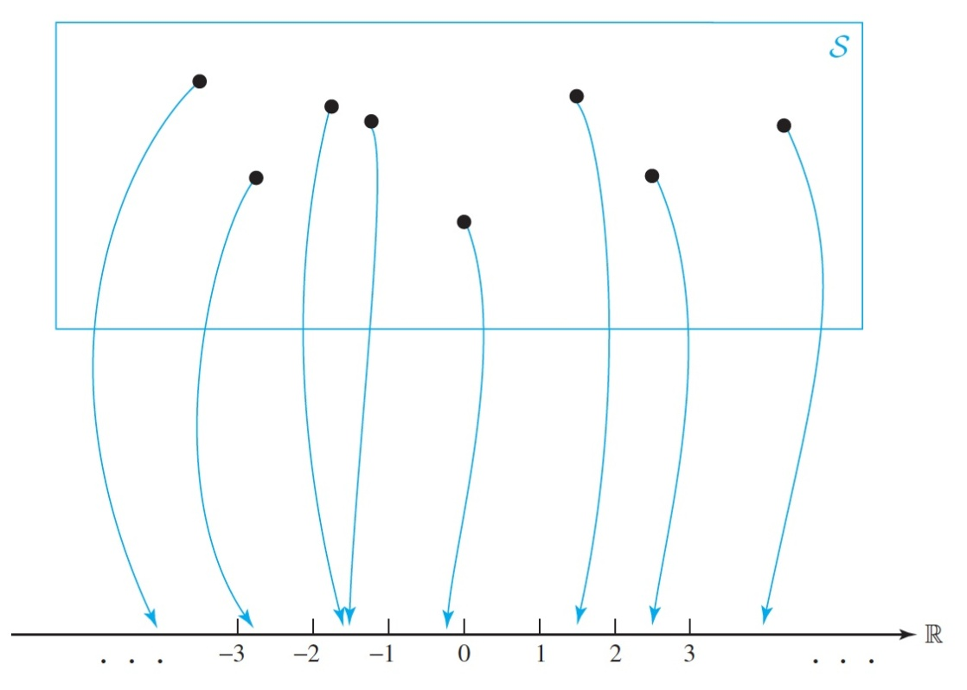

Definition of Random Variables
A random variable is obtained by assigning a numerical value to each outcome of a particular experiment.
A random variable can be thought of as being generated from a function that maps each outcome in a sample space onto the real number line R, as illustrated in the Figure.

Slide 5
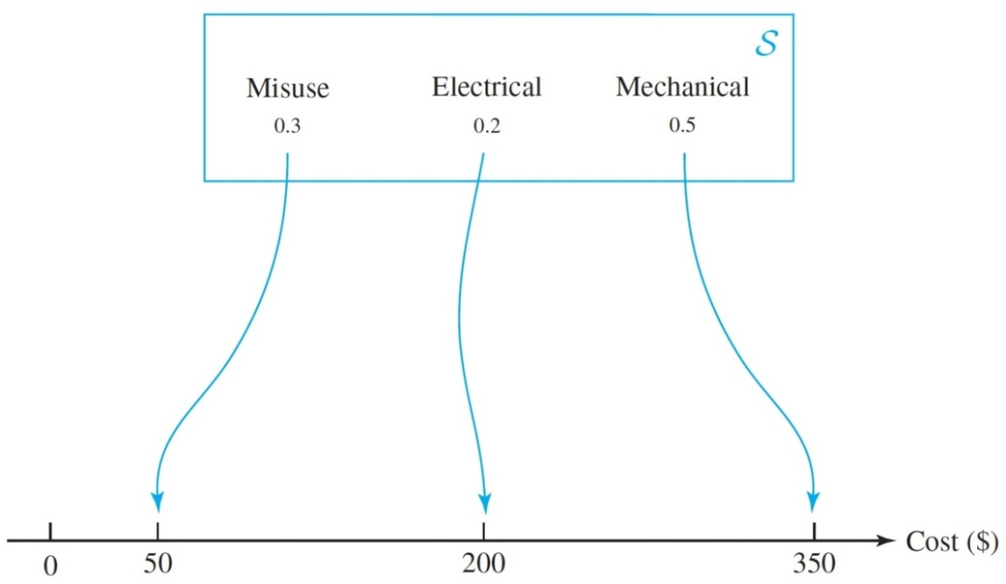
Definition of Random Variables
Example 1: The sample space for the machine breakdown problem is
= {electrical, mechanical, misuse}
and each of these failures may be associated with a repair cost. For example, suppose that electrical failures generally cost an average of $200 to repair, mechanical failures have an average repair cost of $350, and operator misuse failures have an average repair cost of only $50. These repair costs generate a random variable cost, as illustrated in the Figure, which has a state space of {50, 200, 350}.
Cost is a random variable because its values 50, 200, and 350 are numbers. The breakdown cause, defined to be electrical, mechanical, or operator misuse, is not considered to be a random variable because its values are not numerical.

Slide 6
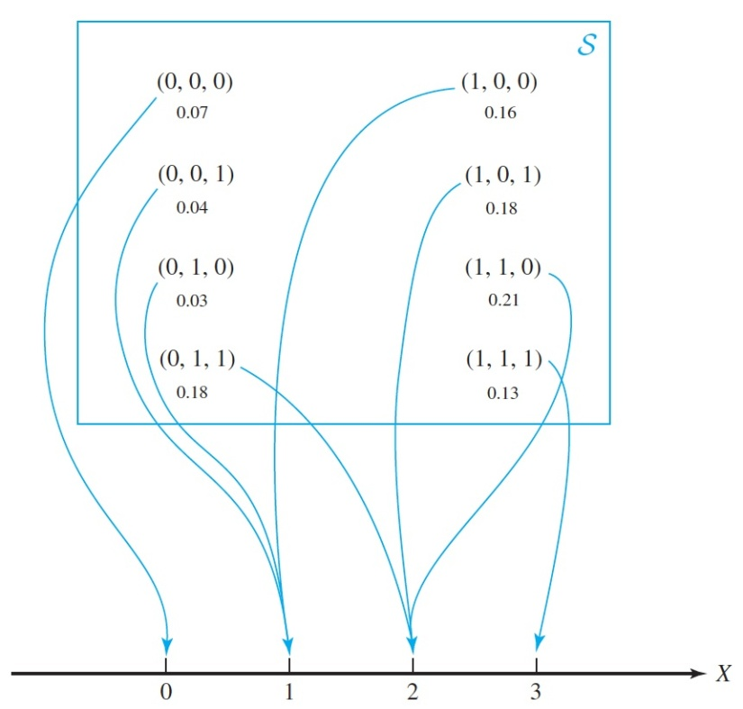
Definition of Random Variables
Example 2: Recall the “power plant operation” example. Suppose that interest is directed only at the number of plants that are generating electricity. This creates a random variable
X = number of power plants generating electricity
which can take the values 0, 1, 2, and 3, as shown in the following Figure.
X = number of power plants generating electricity

Slide 7
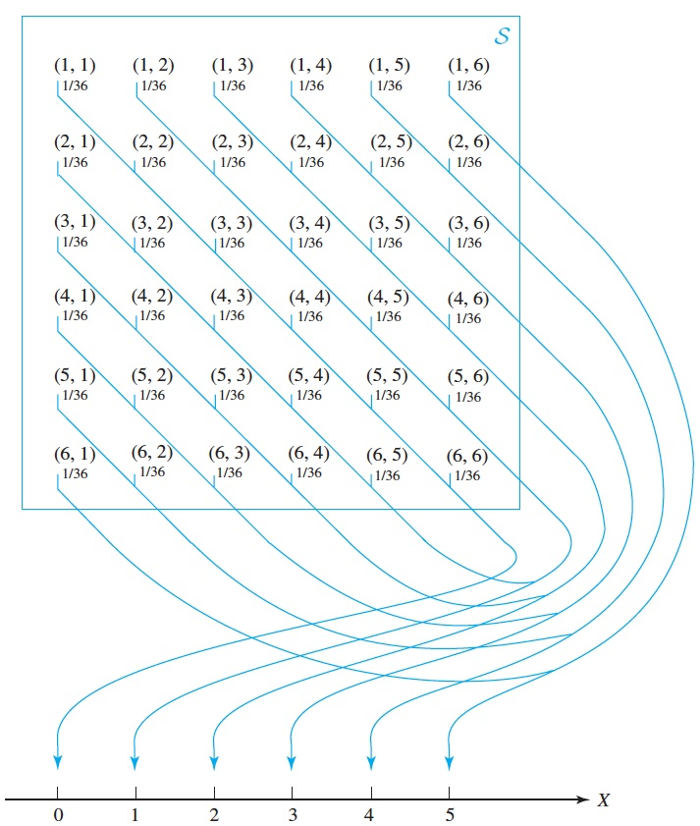
Definition of Random Variables
Example 3: The score obtained from the roll of a die can be thought of as a random variable taking the
values 1 to 6.
If two dice are rolled, a random variable can be defined to be the sum of the scores, taking the values 2 to 12.
The Figure illustrates a random variable defined to be the positive
difference between the scores obtained from two dice, taking the values 0 to 5.
discrete random variables

Slide 8
Definition of Random Variables
A random variable is a function that associates a real number with each element in the sample space .
Random variables are denoted by capital letters and the values they take (their outcomes) with lowercase.

Slide 9



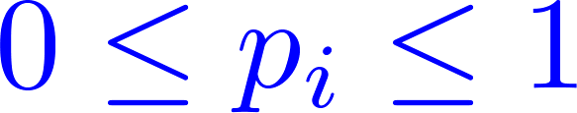
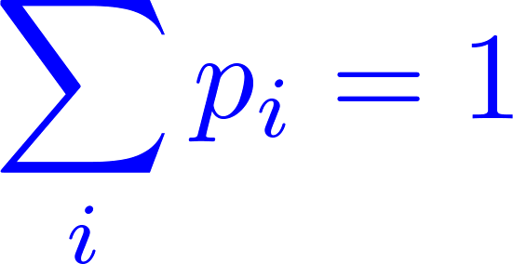
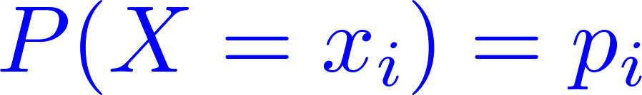
Distribution of a Random Variable
Probability Mass Function (p.m.f) of a random variable is a set of probability values assigned to each of the values taken by the discrete random variable. These probability values must satisfy and
The probability that the random variable takes the value is said to be , and this is written
The is called probability function (p.f.) for

Slide 10
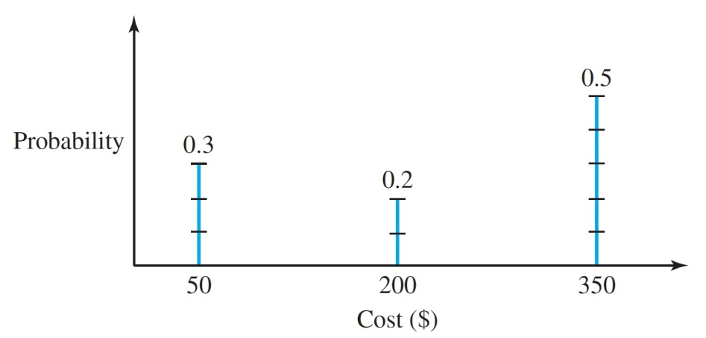
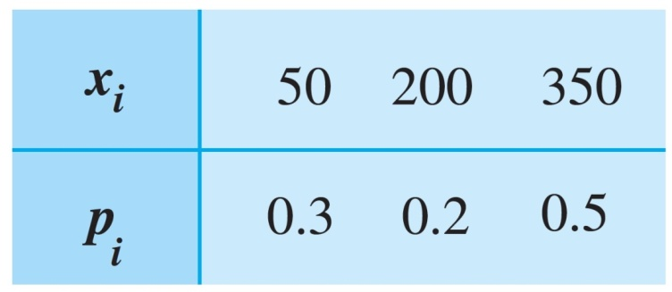
Distribution of a Random Variable
The probability mass function (p.m.f) is also referred to as the distribution of the random variable. The probability mass function may typically be given in either tabular or graphical form as illustrated in the following examples.
Tabular presentation of the probability mass function for machine breakdown costs
Line graph of the probability mass
function for machine breakdown costs

Slide 11

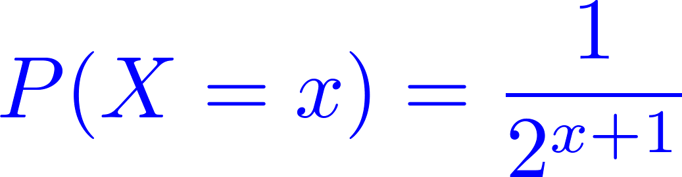
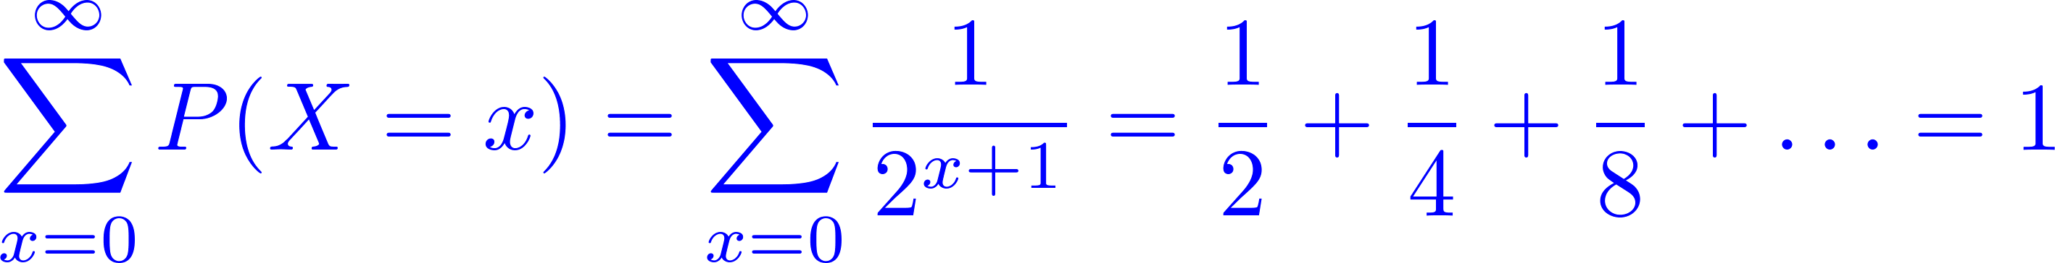
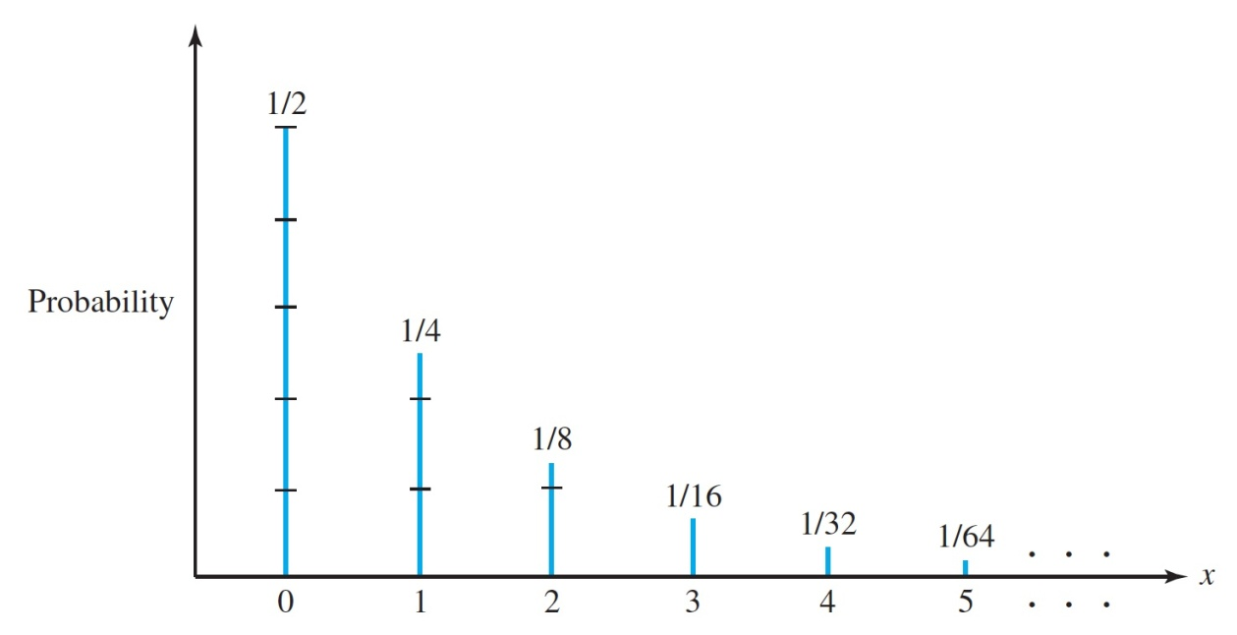
Distribution of a Random Variable
Example 4: Suppose that the probability of having accidents is
This is a valid probability mass function since
so that the probability
values sum to 1.

Slide 12


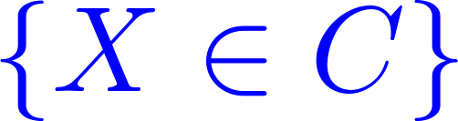


Distribution of a Random Variable
Distribution: Let be a random variable. The distribution of is the collection of all probabilities of the form for all sets of real numbers such that is an event.
Discrete Distribution: We say that a random variable
has a discrete distribution or that is a discrete random variable if can take only a finite number
of different values or, at most, an infinite sequence of different values

Slide 13



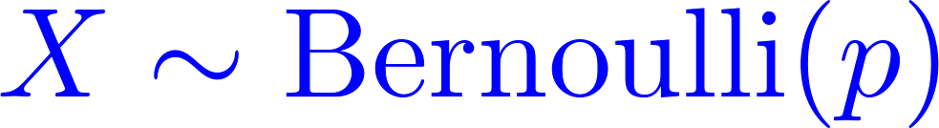
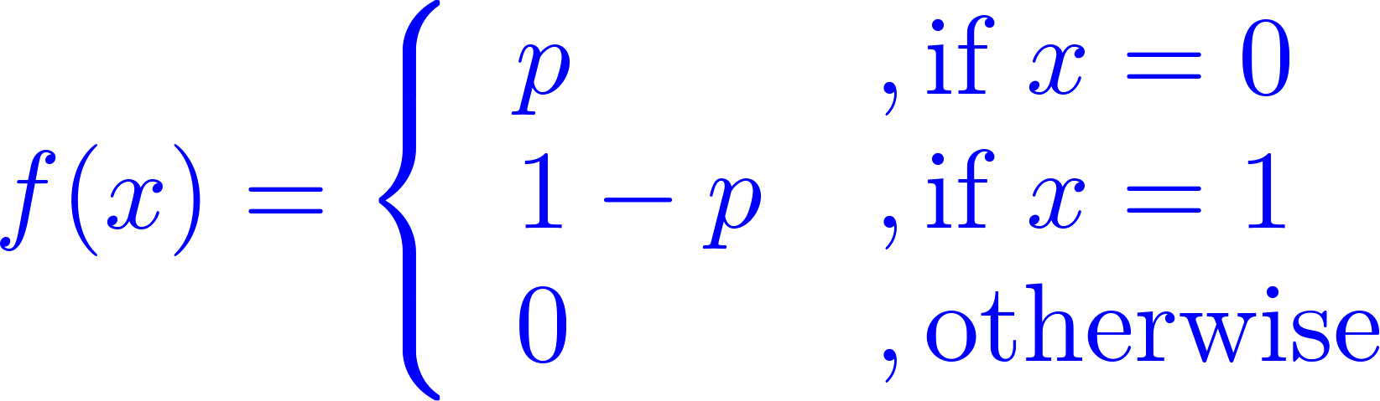
Distribution of a Random Variable
Bernoulli Distribution: Let be the probability of winning a bet and define if we loose and if we win. Then has the Bernoulli distribution with
parameter , often denoted , and the p.f. is
See [1, Example 3.1.6, Chapter 3]

Slide 14
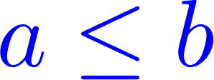
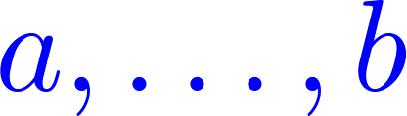
Uniform Distributions on Integers
Uniform Distribution on Integers. Let be integers. Suppose that the value of a random variable is equally likely to be each of the integers . Then we say that has the uniform distribution on the integers .

Slide 15
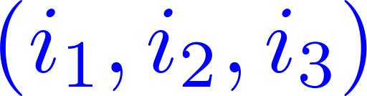
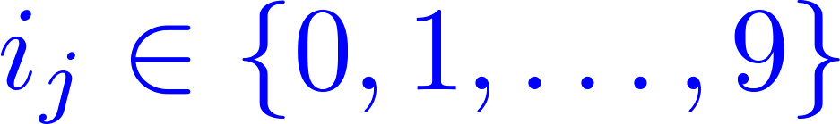
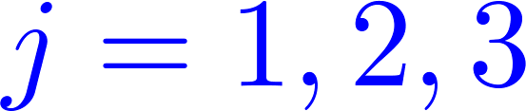
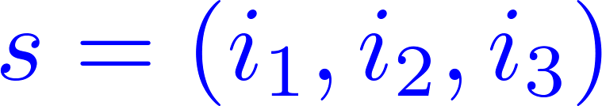
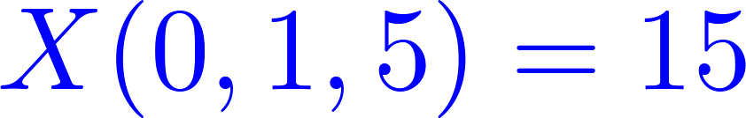

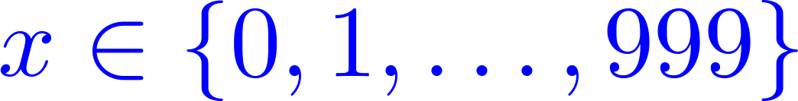
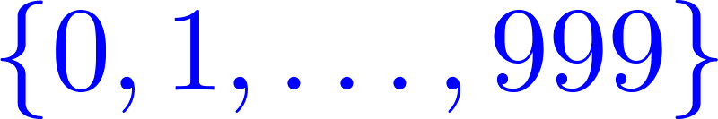
Uniform Distributions on Integers
Example 5: Daily Numbers. A popular state lottery game requires participants to select a three digit number (leading 0s allowed). Then three balls, each with one digit, are chosen at random from well-mixed bowls.
The sample space here consists of all triples
where for . If define
For example, . It is easy to check that
for each integer
The in this example has the uniform distribution on the integers

Slide 16

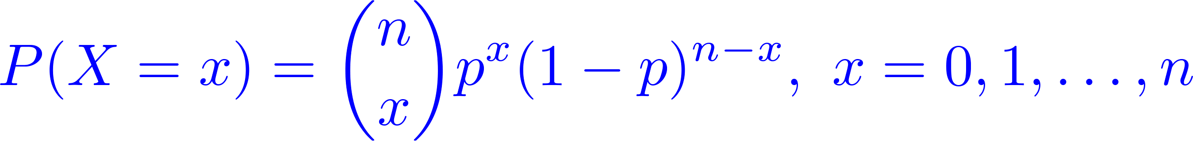
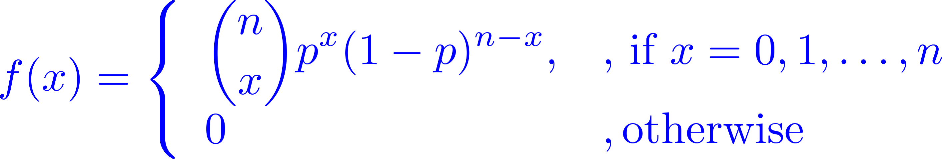
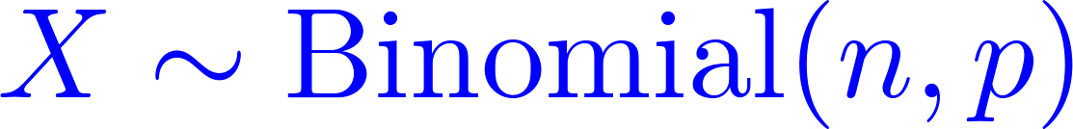
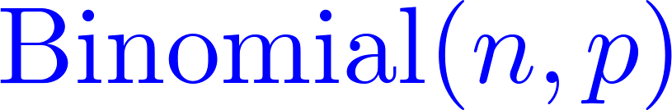
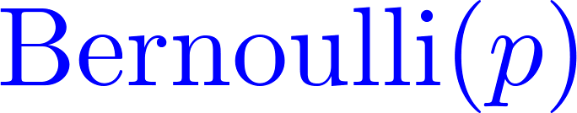
Binomial Distributions
= the number of “successes” in independent trials, where the probability of success is . Then
so the pf is
is said to have the Binomial distribution with parameters and , often denoted
A random variable is a sequence of independent trials.

Slide 17
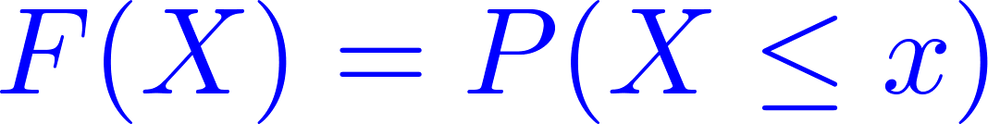
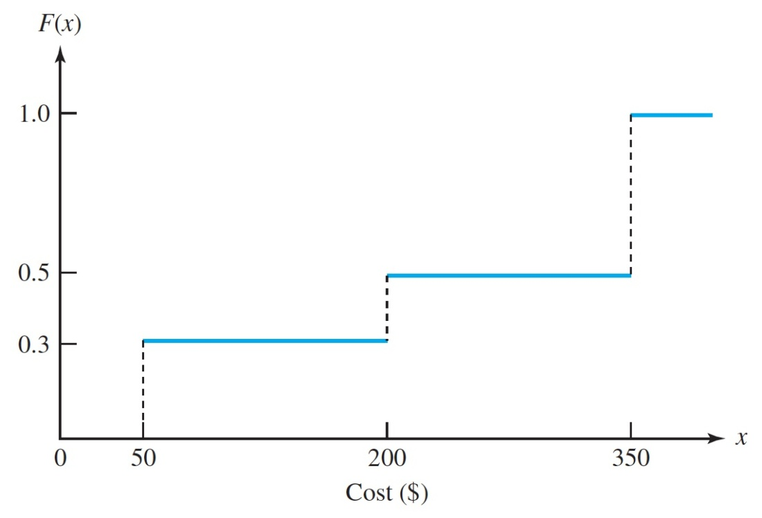
Cumulative Distributions
The cumulative distribution function (c.d.f.) of a random variable is the function
this function it can be used for both discrete and continuous random variables.
The probability mass function can be used to construct the cumulative distribution function as follows:

Slide 18
continuous distributions
The Probability Density Function (p.d.f.)
Nonuniqueness of the p.d.f.
Uniform Distributions on Intervals
Other Continuous Distributions

Slide 19
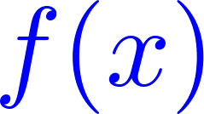
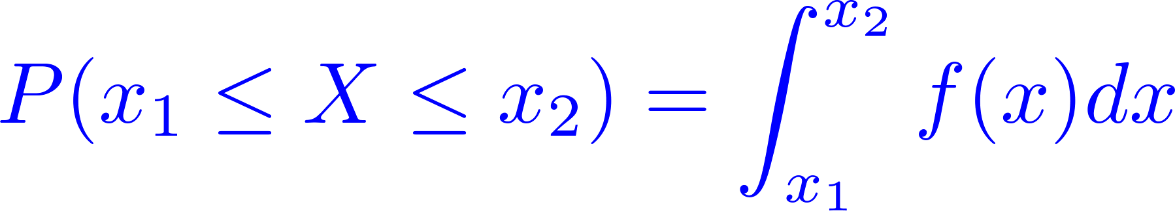
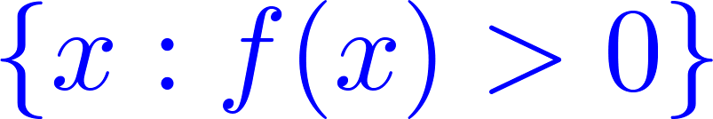
The Probability Density Function (p.d.f.)
Definition: A random variable is said to have a continuous distribution if there exists a non-negative function defined on the real line such that
The function is called the probability density function (pdf). The closure of the set is called the support of .

Slide 20
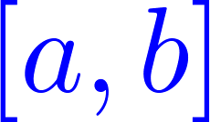
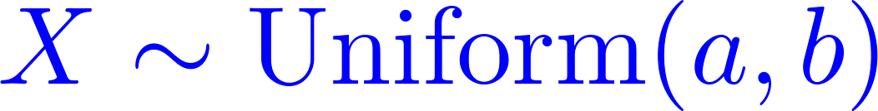
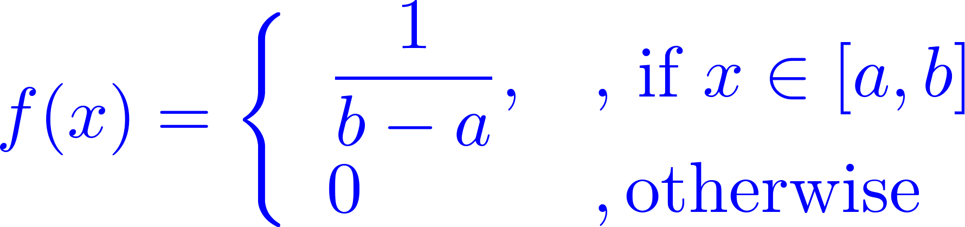
The Probability Density Function (p.d.f)
Example 6: If is Uniformly distributed in or
every interval in has probability proportional to it’s length. The p.d.f is

Slide 21
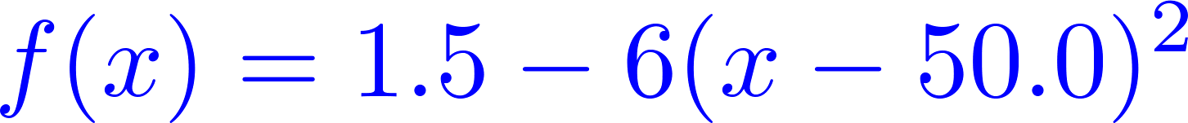
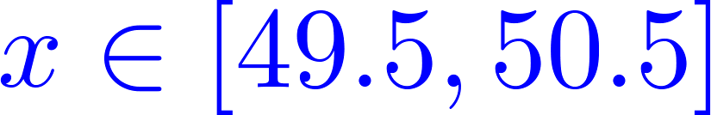
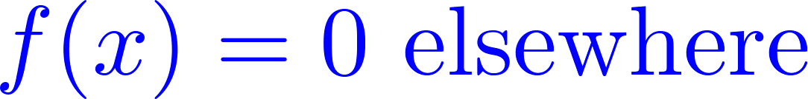
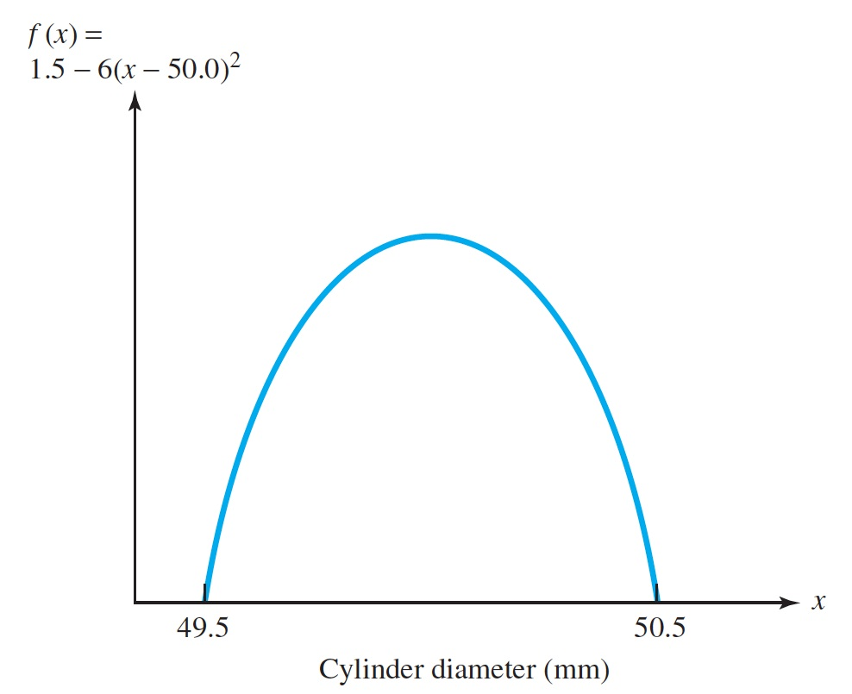
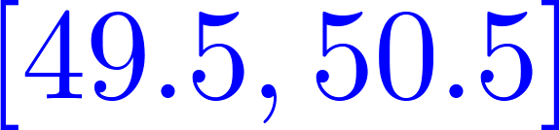
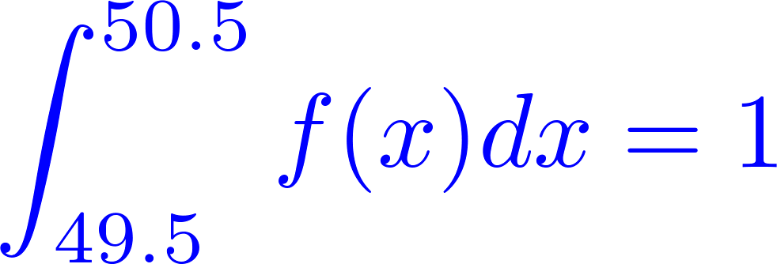
The Probability Density Function (p.d.f.)
Example 7: Suppose that the diameter of a metal cylinder has a probability density function
for , and
This is a valid probability density function because it is positive within the state space and
because

Slide 22
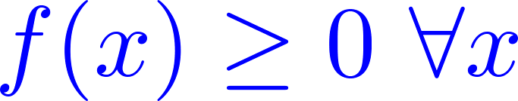
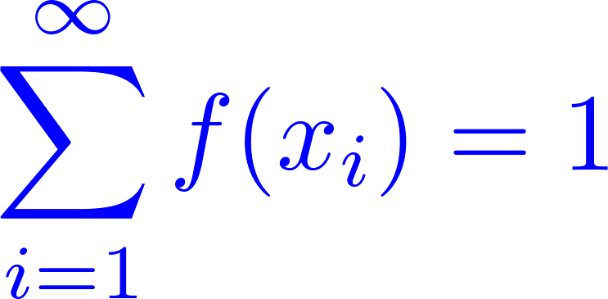
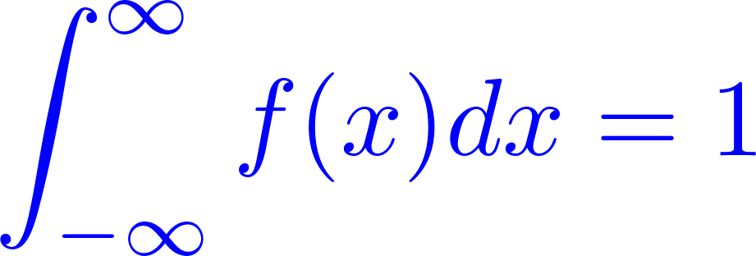
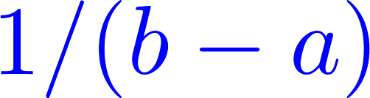
The Probability Density Function (PDF)
Properties of p.d.f. and p.f.: A function f (x) is a p.d.f. (or p.f.) of a random variable if and only if both
of the following holds
The function
With PF:
with PDF:
The coefficient (e.g. ) that ensures the condition 2 is satisfied is called the normalizing constant.

Slide 23
Summary
1
Random Variables and Discrete Distributions
2
Continuous Distributions

